Slide 1
Investigation and Evaluation of Chronic Kidney Disease of Uncertain Aetiology

Slide 2
CONTENT OF THE PRESENTATION
Background
Study Components and research findings
  Prevalence and Causative Factors for CKDu in Sri Lanka
  Socioeconomic and productivity impact of CKDu
  Nephrotoxic herbal remedies used in Sri Lanka
  Randomized Clinical trial to examine the renal effects of an Angiotensin Converting enzyme Inhibitor (Enalapril) in adults with CKDu
Recommendations
Future Studies

Slide 3
Background
Increase in a new form of CKD which is NOT attributed to DM, HT, GN or other known aetiologies observed
Case load more in certain areas i.e. regional clustering
Insidious onset which probably starts in second decade of life
Slowly progressive and asymptomatic until very advanced
High economical cost for patient, family & state

Slide 4
Global Situation
Source: Centre for Public integrity, Washington DC
Notes:
Investigative Journalist – El Salvador, Laos, Vietnam, Andhra Pradesh, Bangladesh
Balkan Endemic Nephropathy among several small discrete communities along the Danube river and its major tributaries
In Central America, CKDu has been reported in Nicaragua among a local group of ex-sugar cane workers and El Salvador particularly among younger men and in certain regions of the Pacific coast
In some villages in Uddanam in the remote agriculutre belt of Andhra Pradesh, India, as much as 37 percent population is affected

Slide 5
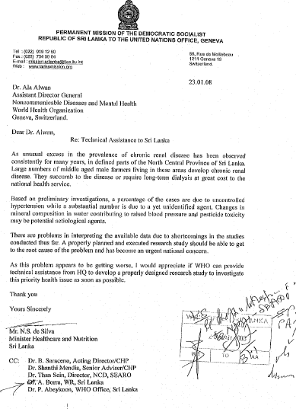

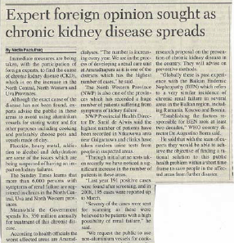
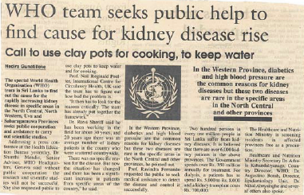
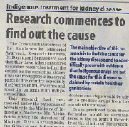
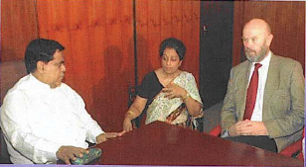
INVOLVEMENT OF WHO -2008
Technical assistance requested by Minister of Health to WHO HQ
  For review of available data
  To initiate a coordinated, multisectoral research effort
Add the letter and a phon picture of

Slide 6
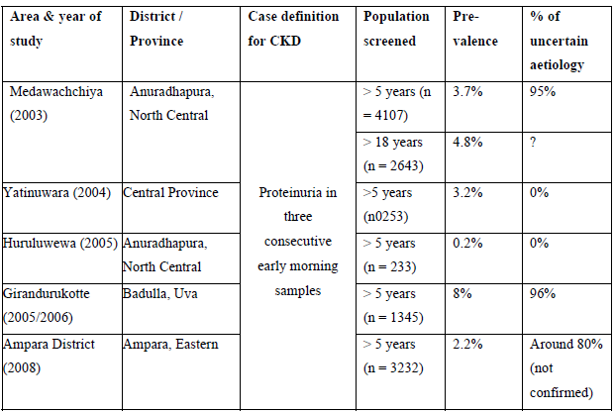

JUSTIFICATION FOR A NATIONAL RESEARCH EFFORT….
Multiple Prevalence Rates!
Multiple Causative Agents!
Definition of CKDu to be established and used as a standard screening tool
Representativeness and nature of populations screened unclear
Geographical mapping piece meal
Little coordination of epidemiological, analytical & environmental studies
BIO TERRORISM
HERBAL
REMEDIES
PESTICIDES
CADMIUM
FLOURIDE
WATER
FERTILLISERS
ALUMINIUM
Notes:
Standard screening tool with optimal sensitivity and specifity and excludes CKD caused by known causes needed – most research use dipstick protein

Slide 7
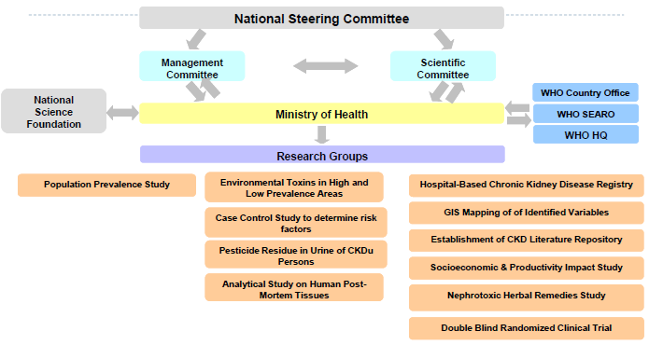
ORGANISATIONAL STRUCTURE OF THE COLLABBORATIVE RESEARCH EFFORT

Slide 8
STRENGTHS OF THE STUDY
Use of consistent case definition of CKDu
Analysis of a range of biological samples from CKDu subjects and controls
Comparison of control groups within and outside the endemic area
Use of sensitive analytical techniques
Heavy metals, metalloids and other elements in environmental samples were analysed

Slide 9
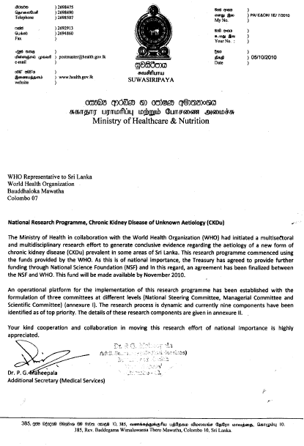
Study Teams
Ministry of Health
Universities
Bandaranayake Memorial Ayurvedic Research Institute
Provincial & Regional Health Authorites
National Water Supply & Drainage Board
ORGANISATIONAL STRUCTURE OF THE COLLABBORATIVE RESEARCH EFFORT (Cont..)
Functions & Responsibilities of Main stakeholders identified
Terms of Reference developed
Committee Members appointed
Study teams formulated
Notes:
Ministry of Health = Colleges, Epidemiology unit, EOH, NCD unit, MRI

Slide 10
MAIN SUB PROJECTS OF THE CKDu RESEARCH
I. Prevalence and Causative Factors for CKDu in Sri Lanka
II. Randomized Clinical trial to examine the renal effects of an Angiotensin Converting enzyme Inhibitor (Enalapril) in adults with CKDu
III. Socioeconomic and productivity impact of CKDu
IV. Nephrotoxic herbal remedies used in Sri Lanka
Notes:
Standard screening tool with optimal sensitivity and specifity and excludes CKD caused by known causes needed – most research use dipstick protein

Slide 11
MAIN SUB PROJECTS OF THE CKDu RESEARCH
I. Prevalence and Causative Factors for CKDu in Sri Lanka
II. Randomized Clinical trial to examine the renal effects of an Angiotensin Converting enzyme Inhibitor (Enalapril) in adults with CKDu
III. Socioeconomic and productivity impact of CKDu
IV. Nephrotoxic herbal remedies used in Sri Lanka
Notes:
Standard screening tool with optimal sensitivity and specifity and excludes CKD caused by known causes needed – most research use dipstick protein

Slide 12
I. Prevalence and Causative Factors for CKDu in Sri Lanka
Comprised of the following study components:
Ia
Population Prevalence Study
Geographical Mapping of identified variables
Establishment of a literature repository for CKD
Analytical & Environmental Studies
Hospital Based CKD registry
Ib
Ic
Id
Ie

Slide 13
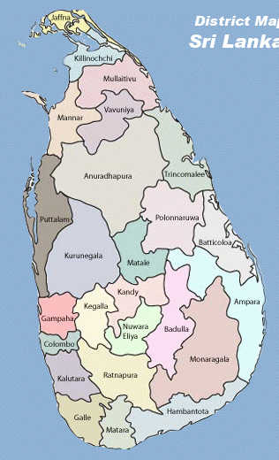



Ia
Population Prevalence Study
6 Divisional Secretariat Areas
22 Gramaniladhari Divisions
2200 Households
(100 Houses from each GN)
6,698 total eligible
6,132 responded to questionnaire
4,941 sampled (15-70 years)
3 Districts
Response Rate
74%

Slide 14
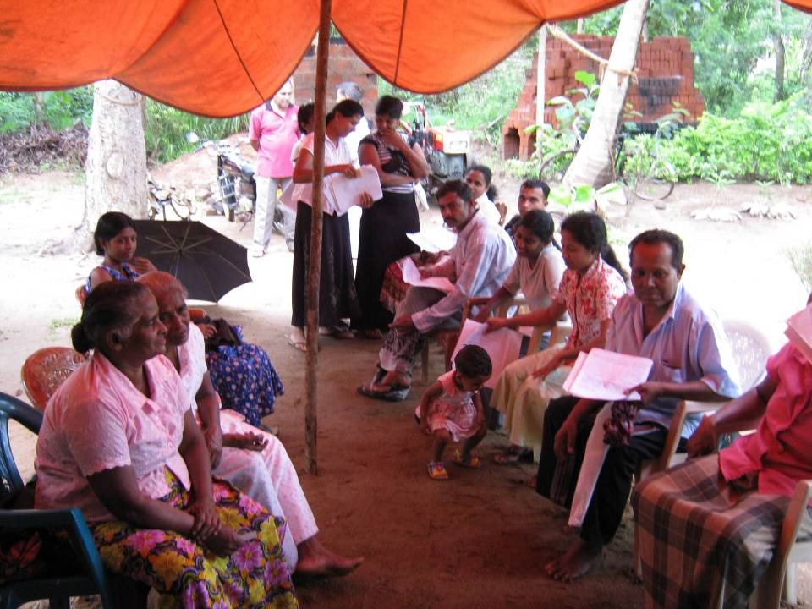
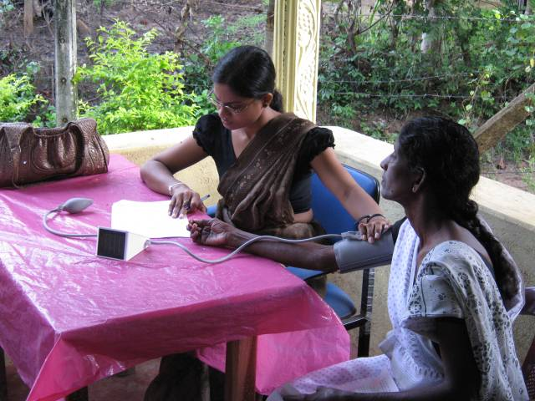
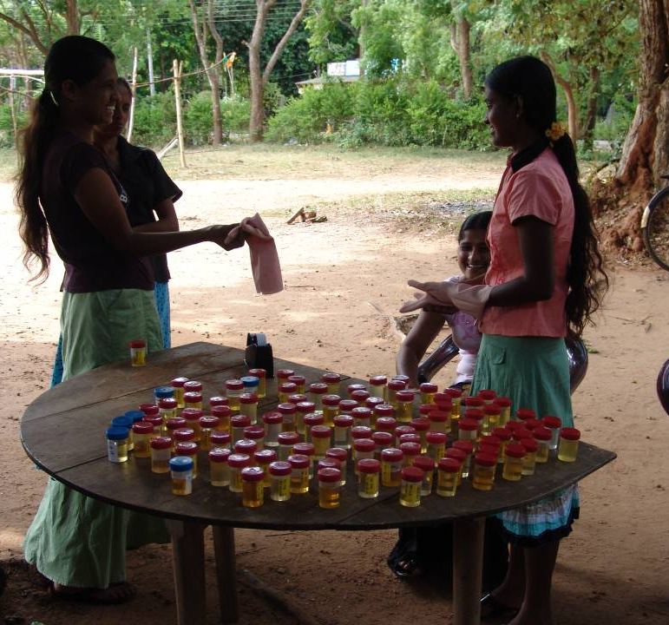
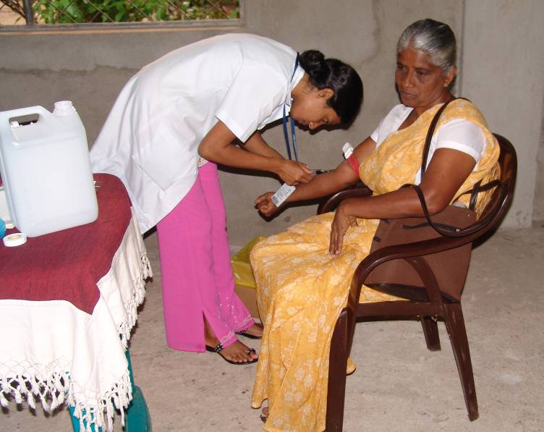
Ia
Population Prevalence Study (Cont..)
Participant Selection
6,698
Informed Consent
Detailed Questionnaire
6,132
Early Morning Urine Sample for Urine ACR 4,941
Repeat Urine ACR
HbA1C
Serum Creatinine
1,308
Physical Examination
Methodology:
If ACR > 30mg/g
Capacity built of 50 Field volunteers from the study areas
Notes:
Capacity of 50 field workers from the areas were built

Slide 15
Ia
Population Prevalence Study (Cont..)
Case Definition for Chronic Kidney Disease of Uncertain Aetiology (CKDu)
    Urine ACR ≥ 30 mg/g on two occasions
    No past history of ureteric calculi, glomerulonephritis, pyelonephritis or snake bite
    Not on treatment for diabetes
    Normal HbA1C (< 6.5%)
    If on treatment for raised Blood pressure BP < 140/90m if not on treatment for Blood pressure, BP < 160/100

Slide 16
Ia
Population Prevalence Study (Cont..)
Grading of Chronic Kidney Disease of Uncertain Aetiology (CKDu)
Grade 1
Persistent Albuminurea and eGFR >90ml/min/1.73m²
Grade 2
Persistent Albuminurea and eGFR 60-89 ml/min/1.73m²
Grade 4
Persistent Albuminurea and
eGFR < 30 ml/min/1.73m²
Grade 3
Persistent Albuminurea and eGFR 30-59 ml/min/1.73m²
Grading Based on eGFR

Slide 17
RESULTS
PREVALANCE OF CKDu
Age standardized prevalence of CKDu was higher in Females 16.9% (95%o CI = 15.5% to 18.3%) than Males 12.9% (95%o CI = 11.5% to 14.4%)
Advanced grades (severe) of CKDu seen more among males (p<0.001)
In both sexes the prevalence increased with increasing age (p<0.001)
Prevalence was higher with increasing age in both sexes (p < 0.05)
20% of CKDu cases had family history of kidney disease
 | Males | Females
Grade 1 | 27.0% | 53.3%
Grade 2 | 27.9% | 32.0%
Grade 3 | 23.2 % | 7.4%
Grade 4 | 22.0 % | 7.3%

Slide 18
RESULTS
PREVALANCE OF CKDu
Why is there a difference in Male & Female prevalence?
Low iron stores in females in lower socio economic groups has influence on excretion of heavy metals and oxidative stress on the kidney – making kidneys more vulnerable to CKDu – resulting in higher prevalence in females
Male sex has been reported to be a risk factor for
progression to end-stage renal disease, and this may
partly explain the occurrence of more severe stages of
CKDu in men

Slide 19
RESULTS
PREVALANCE OF CKDu
Family history of kidney disease in parents or siblings in 20% individuals with CKDu
From individuals with CKDu
    2.1% had ischaemic heart disease and/or cerebrovascular disease
    0.4% had long term use of herbal medicine for hypertension
    1.8% had a history of long term use of Aspirin
    0.6% had a long term use of Analgesics
Being up Male reduced the risk of CKDu (OR=0.745, 95% CI=0.562 to 0.988, P<0.05)
Being older than 39 years increased the risk of CKDu (OR=1.926, 95% CI=1.561 to 2.376, P<0.001)
Advanced grades (severe) of CKDu seen more among males (p<0.001)
In both sexes the prevalence increased with increasing age (p<0.001)
Prevalence was higher with increasing age in both sexes (p < 0.05)
20% of CKDu cases had family history of kidney disease

Slide 20
RESULTS
SUMMARY RESULTS OF LOGISTIC REGRESSION ANALYSIS FOR EXPOSURE
Occupation Type – Being a chena cultivation increased OR by 19.5%
Type of Agriculture – Engaging in paddy cultivation compared to cultivation of vegetables and other crops(chena cultivation) decreased OR by 26.8%
Older Age, being female, being a farmer and being engaged in non-paddy cultivation increased the odds of CKDu
Notes:
All results adjusted for sex and age differences
OR<1 Means protective and OR>1 means that the exposure increases the odds for CKDu

Slide 21
RESULTS
DEMOGRAPHIC CHARACTESTICS OF CKDu CASES
Characteristic | Endemic Area |  | Non Endemic Area
 | CKDu cases | Controls | Controls
Total Number | 733 | 4044 | 250
Males, % | 37.1 | 42.5 | 56
Age (years), mean (SD) | 39.1 (14.2) | 43.7 (13.9) | 35.5 (14.0)
Farmer,% | 38 | 43.9 | 18.3
BMI,kg/m2, mean (SD) | 22.3 (4.6) | 21.1 (4.1) | 21.7 (4.4)
ACR > 30 mg/g | 733 | 0 | 0
ACR Albumin-Creatinine ratio, BMI Body Mass Index, SD standard deviation

Slide 22
Ib
Analytical & Environmental Studies
This comprised of the following Components:
Cross Sectional Comparison of potential environmental toxins in endemic and non endemic areas for CKDu
Case-Control Studies comparing newly diagnosed cases of CKDu and matched controls to identify risk factors for CKDu
Determination of pesticide residues
Analytical Studies of Human postmortem tissues

Slide 23
Ib
Analytical & Environmental Studies
Case-Control Studies comparing newly diagnosed cases of CKDu and matched controls to identify risk factors for CKDu
Response Rate 74%
(n=4957)
ACR>30mg/g on two occasions & other criteria satisfied
(n=733)
No diabetes, kidney diseases, CKDu & snake bite
(n=4044)
Urine Arsenic, Cadmium & Lead | n=495 | n=132
Urine for other elements | n=107 | N=0
Serum Selenium, Strontium etc | n=171 | N=0

Slide 24
SPECIMEN HANDLING AND ANALYSIS
Samples were collected in uncontaminated collection vials and stored frozen (−20°C) until transfer to the laboratory.
All analyses were performed in a contract laboratory (Laboratory of Pathophysiology of the University of Antwerp, Belgium), which has an external quality control scheme for analysis of trace elements.
Measurements of Arsenic, Cadmium, Lead and other elements in urine was performed by inductively coupled plasma mass spectrometry (MS).
Serum analyses were performed by electrothermal atomic absorption spectrometery.
Limits of detection for Aluminium, Strontium, Chromium and Selenium were 0.1 μg/l, 0.5 μg/l, 0.01 μg/l and 1 μg/l respectively.

Slide 25
RESULTS
RESULTS OF URINE – Arsenic, Cadmium & Lead
 | Arsenic (ug/g creatinine) |  |  | Cadmium (ug/g creatinine) |  |  | Lead (ug/g creatinine)
 | CKDu Cases | Controls from Endemic Area (EA) | Controls Non Endemic Area (NEA) | CKDu Cases | Controls from Endemic Area (EA) | Controls Non Endemic Area (NEA) | CKDu Cases | Controls from Endemic Area (EA) | Controls Non Endemic Area (NEA)
 | n=495 | n=132 | n=250 | n=495 | n=132 | n=250 | n=495 | n=132 | n=250
Mean | 45.447 | 92.443 | 56.572 | 1.039 | 0.646 | 0.345 | 1.153 | 1.254 | 2.099
Median | 26.3 | 6.99 | 42.025 | 0.695 | 0.18 | 0.265 | 0.95 | 0.793 | 1.434
Range | 0.4 - 616.6 | 0.2 - 966.29 | 5.38-350.28 | 0.005-8.93 | 0.005-5.13 | 0.005-2.079 | 0.04-8.53 | 1.21-6.64 | 0.277-20.9
The sensitivity & specificity for concentrations of Cadmium in urine were 80% and 53.6% (AUC=0.682, 95% CI=0.61 to 0.75, cut off value > 0.23)
At a cut-off value of ≥0.397 μg/g, sensitivity was 70% and specificity 68.3%.
The sensitivity and specificity for the concentration of arsenic in urine were 90% and 23.2% respectively (AUC = 0.64, 95% CI = 0.58 to 0.71, cut-off value ≥88.57 μg/g).
The concentration of lead in urine was a poor predictor of CKDu (AUC = 0.53, 95% CI 0.38 to 0.67)

Slide 26
RESULTS
RESULTS OF URINE
In Subjects with CKDu urine Cadmium excretion was significantly higher compared to control in both endemic and non endemic areas
Controls in the endemic area compared to those in the non endemic area also had significantly higher urinary excretion of Cadmium.
2
1
4
3
Dose-response analysis showed that Cadmium exposure is a risk factor for the development of CKDu* *
The sensitivity and specificity for Urine Cadmium were 80% and 53.6% respectively*
**P = 0.019 for stage 3 and P = 0.024 for stage 4.
*AUC=0.682, cut off value >0.23µg/g
Notes:
For Urine Cadmium at a cut off value of > 0.397 ug/g sensitivity was 70% and specificity was 68.3%

Slide 27
RESULTS
RESULTS OF URINE
6
The sensitivity and specificity for concentration of Arsenic in urine was 90% and 23.2% respectively*
The mean urine concentration of Arsenic in CKDu cases was above levels known to cause oxidative injury to kidneys
5
7
There was no significant dose-effect relationship between the concentration of Arsenic, Lead or Selenium in Urine and the stage of CKDu
*AUC = 0.64, 95% CI = 0.58 to 0.71, cut-off value ≥88.57 μg/g)

Slide 28
RESULTS
RESULTS OF URINE
Among CKDu cases, the concentration of Cadmium in Urine was positively correlated with Lead and Arsenic** concentrations in urine
8
9
There was no significant difference in urine Arsenic and Lead concentrations in CKDu cases compared to controls
**Lead (r=0.62, p<0.0001)
Arsenic (r=0.28, p<0.001)

Slide 29
RESULTS
RESULTS OF URINE – Other Metals
Metals mg/g creatinine in CKDu subjects n=107 | Mean | Median | Minimum | Maximum
Sodium | 4105.5 | 3544.00 | 425.00 | 17458.00
Potassium | 917.94 | 800.00 | 243.00 | 2469.00
Calcium | 80.45 | 67.00 | 4.00 | 368.00
Magnesium | 79.89 | 80.00 | 2.00 | 169.00
Copper | 13.34 | 11.00 | 3.70 | 91.10
Zinc | 229.99 | 235.99 | 31.00 | 510.00
Titanium | 0.26 | 0.24 | 0.03 | 0.88
Urine concentrations of sodium, potassium, calcium, magnesium, copper, zinc, and titanium in CKDu cases were within normal limits

Slide 30
RESULTS
RESULTS OF SERUM
Concentration of metals in serum of subjects with CKDu
n= 171
 | Serum Concentration (µg/l)
 | Mean | Median | Minimum | Maximum
Aluminium | 4.13 | 3.00 | 1.00 | 12.00
Chromium | 0.118 | 0.06 | 0.01 | 1.15
Selenium | 88.27 | 84.5 | 50.0 | 121.8
Strontium | 83.17 | 82.00 | 29.00 | 198.00
Serum selenium reference range 54 -163 µg/l
Serum strontium reference range 14 - 84 µg/l

Slide 31
RESULTS
RESULTS OF SERUM
About two-thirds (63%) of CKDu subjects had Selenium levels below 90μg/l.*
2
Serum Aluminium and Chromium levels were within normal levels
1
Serum Strontium levels were above normal limits**
3
*Serum Selenium levels in CKDu subjects ranged from 50.0 μg/l to 121.8 μg/l(reference range = 54 μg/l to 163 μg/l).
A serum selenium concentration of 90 μg/l is required to reach the maximum level of glutathione peroxidise
The sensitivity and specificity for serum selenium were 80% and 60% respectively (AUC = 0.789, cut = off value ≥94.3 μg/l
** Serum strontium levels were above normal limits (mean = 83.17 μg/l, standard deviation [SD] = 32.15 μg/l;
reference range = 14 μg/l to 84 μg/l).
Notes:
Selenium has been s hown to protect kidney from oxidative stress
A selenium concentration of 80-95 mcg/l is needed to maximise activity of the antioxident enzyme Glutathione peroxidase and selenoproteins in plasma
The association of raised serum strontium with raised serum cadmium have been reported – which is probably because of alteration of strontium handling and excretion due to the effect of cadmium on renal tubular function

Slide 32
RESULTS
RESULTS OF NAILS & HAIR
Source |  | Nails | Hair
 |  | Cadmium (ug/g) | Arsenic (ug/g)
Nail – CKDu cases (n=80) | Mean Median Minimum Maximum | 0.017 0.007 0.001 0.347 | 0.144 0.139 0.000 0.452
Nail - Control (n=48) | Mean Median Minimum Maximum | 0.009 0.001 0.001 0.091 | 0.125 0.103 0.006 1.214
1
A significantly higher Cadmium concentration was seen in the nails of CKDu cases*
Arsenic levels in hair were significantly higher in CKDu
Cases**
2
*( P < 0.05).
**( P < 0.05).

Slide 33
KEY MESSAGES
CADMIUM
Cadmium is a known nephrotoxin
Urinary Excretion of Cadmium is a reliable indicator of cumulative long-term exposure to cadmium
The mean urine concentration of cadmium in CKDu cases was above the levels demonstrated in recent studies to cause oxidative stress and decreased glomerular filtration rate and creatinine clearance
A significantly higher cadmium concentration was also seen in the nails of those with CKDu compared to controls from the endemic area.
The results of this study indicate that cadmium exposure is a risk factor for CKDu.

Slide 34
KEY MESSAGES
ARSENIC
The mean urine concentration of arsenic in CKDu
cases was also above levels known to cause oxidative
injury to the kidney
In CKDu cases and controls from the endemic area, concentrations of arsenic in urine and in fingernails were higher than those reported in people living in low-exposure environments.
Urine is a major pathway for excretion of arsenic from
the human body and so urine levels reflect exposure.
In some studies, markers of oxidative stress have been
demonstrated at urine arsenic concentrations as low as
3.95 μg/g

Slide 35
KEY MESSAGES
ARSENIC
The level of total arsenic in urine is associated with chronic kidney disease in a dose–response relationship, especially when the level is greater than 20.74 μg/g.
Co-exposure to cadmium and arsenic is known to produce additive effects on the kidney that are more pronounced than exposure to either metal alone

Slide 36
KEY MESSAGES
SELENIUM
Selenium has been shown to protect the kidney from
oxidative stress
A selenium concentration of 80–95 μg/l is needed to maximise the activity of the antioxidant enzyme glutathione peroxidase and selenoproteins in plasma
Serum Selenium was below 80 μg/l in 38% and below
90 μg/l in 63% of individuals with CKDu.
Low selenium levels may have been a contributory factor increasing the vulnerability of the kidneys to oxidative damage caused by heavy metals and metalloids.

Slide 37
KEY MESSAGES
STRONTIUM
The association of raised Serum strontium levels with
raised serum cadmium levels has been reported previously
Strontium levels were not analysed in food or water.
The most likely explanation is an alteration of
Strontium handling and excretion, owing to the effect of
Cadmium on renal tubular function.

Slide 38
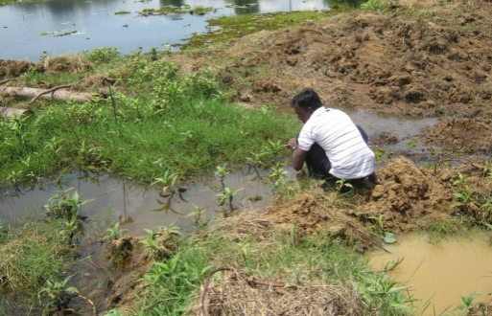
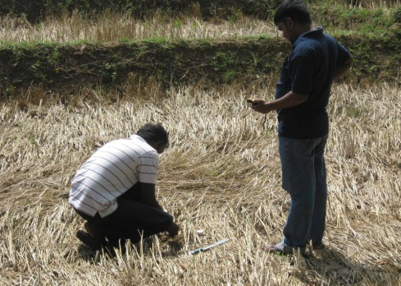
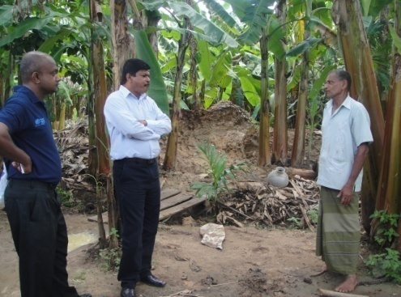
Ib
Analytical & Environmental Studies
Cross Sectional Comparison of potential environmental toxins in endemic and non endemic areas for CKDu
Details of Environmental Samples Collected for cross Sectional Comparison:
Environmental Samples
Water
Food
Tobacco, Beetle & Beedi
Weeds
Soil
Weedicides & Pesticides
Fertillisers

Slide 39
SPECIMEN HANDLING AND ANALYSIS
Samples were collected in uncontaminated collection vials and stored frozen (−20°C) until transfer to the laboratory.
All analyses were performed in a contract laboratory (Laboratory of Pathophysiology of the University of Antwerp, Belgium), which has an external quality control scheme for analysis of trace elements.
Measurements of Arsenic, Cadmium, Lead and other elements in water, vegetables, agrochemicals and soil, was performed by inductively coupled plasma mass spectrometry (MS).

Slide 40
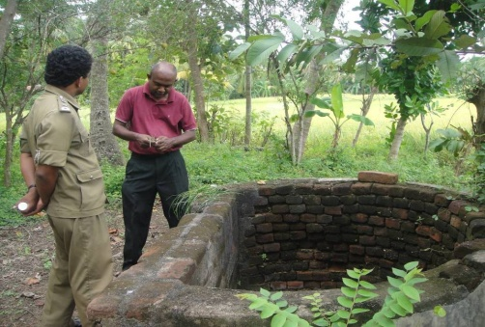
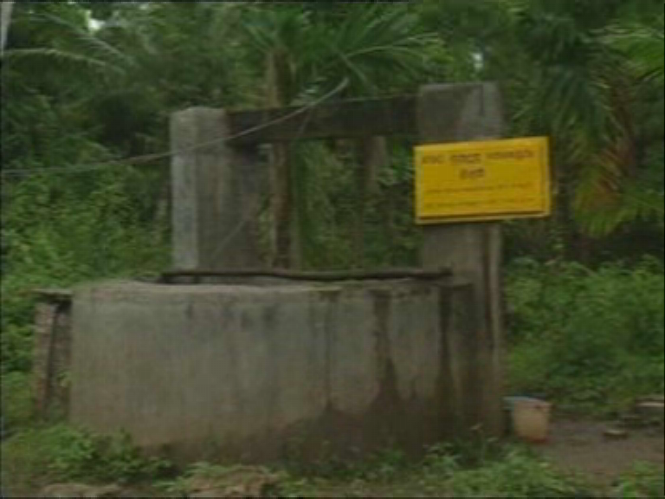
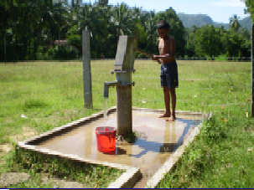
RESULTS
RESULTS OF WATER ANALYSIS
99
Sources of drinking water for individuals with CKDu in Endemic Area
123
Other sources of water from Endemic Area
(From ground wells, tube wells, irrigation canals
12
Non Endemic Area
(from ground well, tube wells and natural springs)
Notes:
US envirnmental protection authority has suggested that the concentration of AS in drinking water should be no more than 5mcg/l

Slide 41
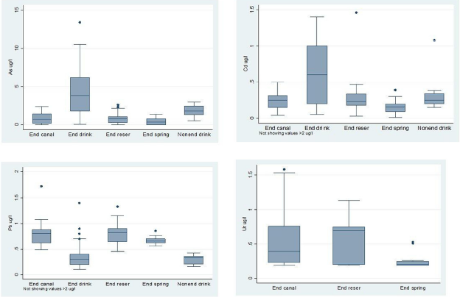
RESULTS
RESULTS OF WATER ANALYSIS
Arsenic
Cadmium
Lead
Uranium
End canal = endemic area canal; End drink = endemic area drinking water; End reser = endemic area reservoir; End spring = endemic area spring;nonend drink = non-endemic area drinking water. Horizontal lines within the boxes represent the median values. The ends of the solid lines extending on either side of the boxes represent the minimum and the maximum. The dark dots are outliers; defined as being more than 1.5 interquartile ranges away from the box. The interquartile range is the distance between the upper part of the box and the lower part of the box.

Slide 42
RESULTS
RESULTS OF WATER ANALYSIS
Arsenic was borderline or raised in four samples* of drinking water used by individuals with CKDu repeat analysis from the four sources showed normal Arsenic levels.
2
1
Levels of Cadmium, Lead and Uranium in sources of drinking water used by individuals with CKDu
were within normal limits.
Reference limits: Arsenic <10 μg /l, Cadmium <3 μg/l, Lead <10 μg/l, Uranium <2 μg/l
*(9.9 μg/l, 10.2 μg/l, 10.5 μg/l,13.4 μg/l).
Notes:
US envirnmental protection authority has suggested that the concentration of AS in drinking water should be no more than 5mcg/l

Slide 43
RESULTS
RESULTS OF WATER ANALYSIS
In water samples from other sources in Endemic area, the Arsenic concentration was 22.2 μg/l and 9.8 μg/l in two samples taken from a canal and a reservoir,
The Cadmium concentration was 3.46 μg/l in one sample from a reservoir
The Lead concentration was 12.3 μg/l in one sample from a reservoir in the endemic area.
All other samples from wells, tube wells, irrigation canals, pipe-borne water, reservoirs and natural springs from endemic and non-endemic area, had normal Arsenic,
Cadmium and Lead levels.
4
3
Reference limits: Arsenic <10 μg /l, Cadmium <3 μg/l, Lead <10 μg/l, Uranium <2 μg/l
Notes:
US envirnmental protection authority has suggested that the concentration of AS in drinking water should be no more than 5mcg/l

Slide 44
KEY MESSAGES
DINKING WATER
The Cadmium content in all water samples analysed was within normal limits, except in one sample from a reservoir that had a borderline cadmium level (3.45 μg/l).
Drinking water is a major pathway for entry of inorganic
Arsenic into the human body.
The arsenic content in 99% of water samples was below the WHO reference value of 10 μg/l.
However, it has recently been suggested that the concentration of arsenic in drinking water should be no more than 5 μg/l.

Slide 45
KEY MESSAGES
DINKING WATER
CKDu occurs in areas where groundwater is the main
source of drinking water. Groundwater in this region is
known to have a high content of Fluoride and Calcium.
People living in the region for generations have used
groundwater for drinking without ill effects.
However –
    hardness of water, the high fluoride content,
    Poor access to drinking water
    Inadequate intake of water in a warm climate
may influence the body burden and/or the excretion of
heavy metals and oxidative damage to the kidneys caused
by heavy metals.

Slide 46
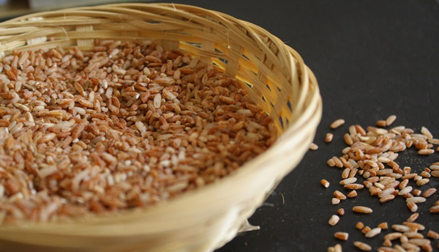
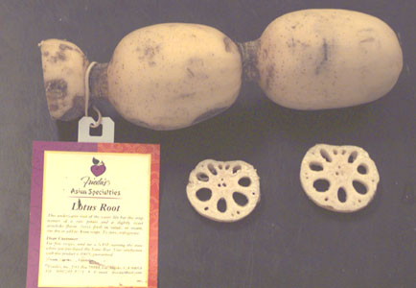
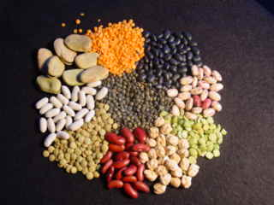
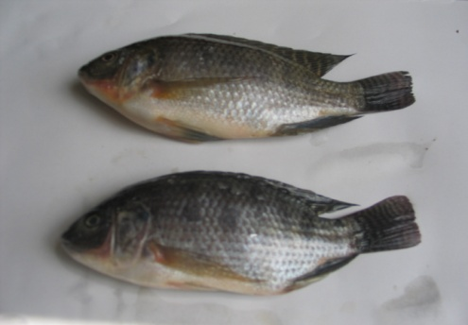
RESULTS
RESULTS OF FOOD ANALYSIS
119
32
Rice, Pulses, Vegetables including leafy vegetables, Coconut, Yams & roots (eg: Kohila, Lotus), Fresh Water fish, Tobacco, Pasture & Weeds from Endemic area
Rice, Pulses, Vegetables including leafy vegetables, Coconut, Yams & roots (eg: Kohila, Lotus), Fresh Water fish, Tobacco, Pasture & Weeds from Non Endemic area

Slide 47
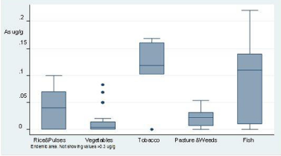
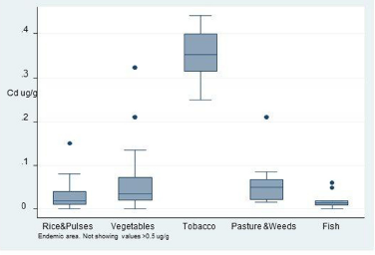
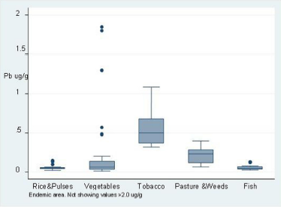
RESULTS
RESULTS OF FOOD ANALYSIS
Arsenic
Cadmium
Horizontal lines within the boxes represent the median values. The ends of the solid lines extending on either side of the boxes represent the minimum and the
maximum. The dark dots are outliers ; defined as being more than 1.5 interquartile ranges away from the box.
Lead
The maximum levels of cadmium permitted by the Codex Alimentarius for vegetables is 0.2 mg/kg and by the Commission of the European Communities is 0.05 mg/kg [The maximum concentration of cadmium stipulated for certain types of fish by the Commission of the European Communities is 0.05 mg/kg.
The maximum concentration of lead stipulated for vegetables by the Commission of the European communities is 0.10 mg/kg .

Slide 48
RESULTS
RESULTS OF FOOD ANALYSIS
The maximum concentration of Cadmium in vegetables in the endemic area was 0.322 mg/kg and in the non endemic areas it was 0.063 mg/kg
Levels of Cadmium in Rice in both Endemic & Non Endemic areas were below the allowable limit (0.2mg/kg)
Levels of Cadmium in certain vegetables such as lotus root, and in tobacco, were high. Levels of Cadmium in lotus and tobacco were higher in endemic than in non-endemic areas
Source |  | Cadmium (mg/kg)
 |  | Endemic Area (EA) | Non Endemic Area (NEA)
Lotus | Mean | 0.413 | 0.023
 | Median | 0.066 | 0.023
 | Maximum | 1.50 | 0.03
Tobacco | Mean | 0.351 | 0.316
 | Median | 0.351 | 0.316
 | Maximum | 0.44 | 0.351
Notes:
Cadmium level in Rice by Codex Alimentarius is 0.2mg/kg
Cadmium Level for vegetables by Codex Alimentarius is 0.2mg/kg by commission of european communities is 0.05mg/kg
Provisional Tolerable Weekly Intake (PTWI) for cadmium is 5.8mcg/kg body weight (Joint FAO/WHO expert Committeeon food additives (JECOFA) in 2010 (previously it was 7mcg/kg body weight)
More recently the scientific panel on contaminants in the food chain recommended lowering PTWI of cadmium to 2.52mcg/kg body weight
The PTWI for lead is set at 0.025mcg/kg body weight per week
The PTWI for Arsenic is 0.015mg/kg body weight per week was withdrawn and the recommendation is to keep the concentration of Arsenic as low as possible

Slide 49
KEY MESSAGES
FOOD
TOBACCO
The maximum level of Cadmium for vegetables permitted
by the Codex Alimentarius is 0.2 mg/kg
The level of Cadmium & Lead permitted by the Commission of the European Communities
    Cadmium - 0.05 mg/kg.
    Lead -0.10mg/kg
The maximum levels in certain vegetables grown in the endemic area exceeded these safety levels.
  Fish -Cadmium (0.06 μg/g)*
  Vegetables in the endemic area - Lead (0.476 mg/kg)
Levels of cadmium and Lead in vegetables and Cadmium
in freshwater fish from the endemic area are above
the maximum levels stipulated by certain Food SafetyAuthorities
also exceeded the European maximum
limit of 0.05 mg/kg stipulated for certain types of fish

Slide 50
KEY MESSAGES
FOOD
TOBACCO
A provisional tolerable weekly intake (PTWI) established by the Joint Food and Agriculture Organisation of UN (FAO) / WHO Expert committee on Food Additives ( JECFA) for body weight per week
Cadmium - 5.8(ug/g) 2.52(ug/g)*
Arsenic - 0.015(mg/kg) Level withdrawn – To keep low
as possible
Lead - 0.025(mg/kg)
Since the Cadmium content of certain food items in the endemic area is above stipulated levels, the total weekly intake of cadmium in people living in the endemic area could exceed these safe limits, with detrimental effects on the kidneys, particularly in vulnerable people and those with predisposing factors.

Slide 51
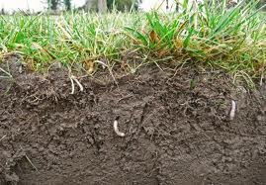
RESULTS
RESULTS OF SOIL ANALYSIS
88
41
Soil samples were obtained from paddy fields, other types of cultivations and reservoirs from Endemic area
Soil samples were obtained from paddy fields and other types of cultivations from Non Endemic area

Slide 52
RESULTS
RESULTS OF SOIL ANALYSIS
Source |  | Arsenic (ug/g) |  | Cadmium (ug/g) |  | Lead (ug/g)
 |  | Endemic Area (EA) | Non Endemic Area (NEA) | Endemic Area (EA) | Non Endemic Area (NEA) | Endemic Area (EA) | Non Endemic Area (NEA)
Paddy EA(n=45) NEA (n=21) | Mean | 0.16 | 0.17 | 0.49 | 0.45 | 16.54 | 14.49
 | Median | 0.11 | 0.08 | 0.43 | 0.40 | 15.75 | 16.95
 | Minimum | 0.00 | 0.01 | 0.16 | 0.01 | 5.03 | 0.02
 | Maximum | 0.85 | 0.99 | 0.56 | 1.61 | 34.54 | 39.95
Chena EA(n=20) NEA (n=10) | Mean | 0.06 | 0.40 | 0.40 | 0.59 | 15.41 | 14.84
 | Median | 0.04 | 0.29 | 0.36 | 0.55 | 13.82 | 13.93
 | Minimum | 0.00 | 0.09 | 0.17 | 0.34 | 8.25 | 5.42
 | Maximum | 0.22 | 1.57 | 1.27 | 0.93 | 28.33 | 26.1
Vegetable Plot EA(n=23) NEA (n=10) | Mean | 0.11 | 0.27 | 3.48 | 0.47 | 17.46 | 18.01
 | Median | 0.07 | 0.24 | 0.37 | 0.41 | 16.76 | 18.03
 | Minimum | 0.00 | 0.08 | 0.16 | 0.29 | 6.69 | 5.57
 | Maximum | 0.46 | 0.53 | 70.00 | 0.84 | 41.02 | 32.87
Crop land EA (n=6) NEA (n=2) | Mean | 0.05 | 0.13 | 0.60 | 0.28 | 20.55 | 7.96
 | Median | 0.06 | 0.13 | 0.5 | 0.28 | 20.29 | 7.96
 | Minimum | 0.00 | 0.09 | 0.17 | 0.24 | 9.98 | 3.15
 | Maximum | 0.01 | 0.18 | 1.47 | 0.33 | 32.1 | 12.77
Reservoir EA (n=6) NEA (n=3) | Mean | 0.60 |  | 0.66 |  | 19.16
 | Median | 0.50 |  | 0.52 |  | 17.16
 | Minimum | 0.17 |  | 0.15 |  | 7.11
 | Maximum | 0.43 |  | 1.36 |  | 33.49

Slide 53
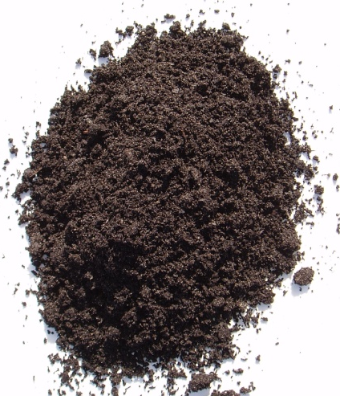
RESULTS
RESULTS OF SOIL ANALYSIS
The mean Cd Concentration of soil from the endemic area was 0.4µg/g.
The level of Cadmium in surface soil in the endemic area (n = 94, excluding samples from reservoirs), was 1.16 μg/g compared to 0.49 μg/g in the non-endemic area (n = 45,excluding samples from reservoirs)
Notes:
Survey of Agricultural soils in the USA and sweden have reported mean Cd concentration in soil as 0.265mg/kg and 0.23mg/kg respectively.
Calcium compete better than Cd for absorption sites in soil

Slide 54
KEY MESSAGES
SOIL
The mean concentration of Cadmium in soil from the
endemic area was 0.4 μg/g.
Surveys of agricultural soils in the USA and Sweden have reported lower soil cadmium levels (0.265 mg/kg and 0.23 mg/kg respectively)
The concentration of Cadmium, Arsenic and Lead
in soil, and their impact on body burden and excretion,
is known to be influenced by many environmental factors:
    pH of soil
    Buffering capacity
    Content of organic matter
    Water quality

Slide 55
KEY MESSAGES
SOIL
Cadmium accumulation by plants, for example, is
influenced by the reactive soil cadmium content and pH.
It is decreased by high cation exchange capacity of
the soil and increased by higher soil temperature
The hardness and high content of fluoride in water in the endemic area may also influence the dynamics of cadmium in soil, absorption by plants and excretion from the kidney.

Slide 56
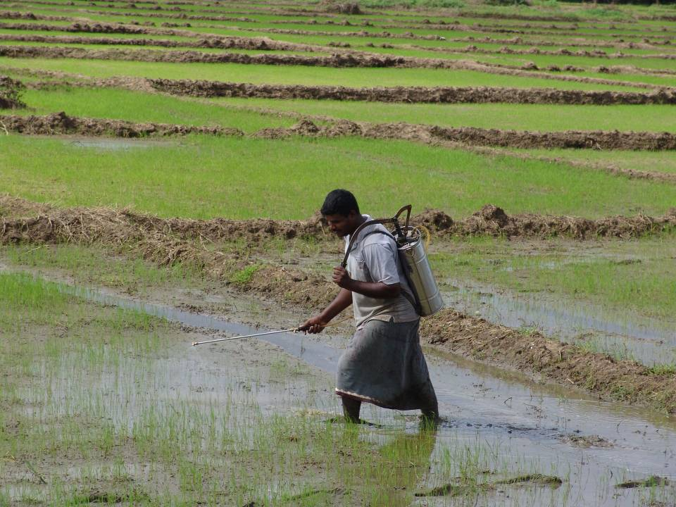
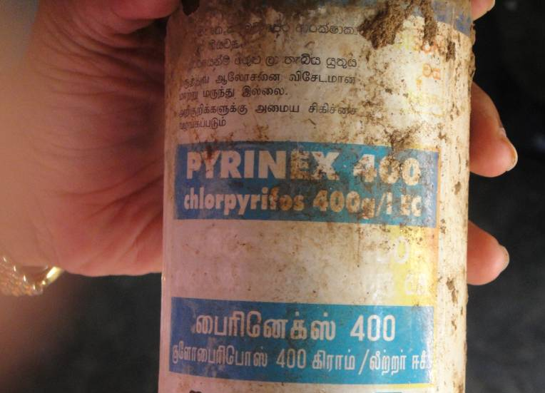
RESULTS
RESULTS OF WEEDICIDES & PESTICIDES
 | Arsenic (ug/g) |  | Cadmium (ug/g) |  | Lead (ug/g)
 | Endemic Area (EA) n=26 | Non Endemic Area (NEA) n=8 | Endemic Area (EA) n=26 | Non Endemic Area (NEA) n=8 | Endemic Area (EA) n=26 | Non Endemic Area (NEA) n=8
Mean | 6.73 | 3.81 | 0.77 | 0.76 | 40.62 | 15.65
Median | 1.68 | 1.38 | 0.31 | 0.3 | 1.79 | 1.89
Minimum | 0.01 | 0.01 | 0.05 | 0.05 | 0.83 | 1.01
Maximum | 94.93 | 13.15 | 9.34 | 2.0 | 930.81 | 56.39
A total of 26 samples analyzed from endemic areas
Notes:
US envirnmental protection authority has suggested that the concentration of AS in drinking water should be no more than 5mcg/l

Slide 57
RESULTS
RESULTS OF PHOSPHATE FERTILIZERS
 | Cadmium (ug/g) |  | Lead (ug/g) |  | Arsenic (ug/g)
 | Endemic Area (EA) n=13 | Non Endemic Area (NEA) n=6 | Endemic Area (EA) n=13 | Non Endemic Area (NEA) n=6 | Endemic Area (EA) n=13 | Non Endemic Area (NEA) n=6
Mean | 2.98 | 0.49 | 94.23 | 20.29 | 0.06 | 0.43
Median | 0.04 | 0.03 | 1.42 | 0.65 | 0.04 | 0.19
Minimum | 0.01 | 0.01 | 0.17 | 0.09 | 0.00 | 0.00
Maximum | 30.79 | 1.28 | 823.41 | 98.52 | 0.19 | 1.22
The maximum acceptable
levels for Cadmium, Lead and Arsenic, in phosphate
fertilizer product, at 1% of the nutrient level, are 4 μg/g, 20 μg/g and 2 μg/g, respectively
A total of 19 samples analyzed
(TSP – 6, MOP – 3, Urea – 7, Mixed - 3)
Notes:
US envirnmental protection authority has suggested that the concentration of AS in drinking water should be no more than 5mcg/l

Slide 58
Determination of pesticide residues
Analytical & Environmental Studies
Ib
SPECIMEN HANDLING AND ANALYSIS
Samples were shipped in dry ice and stored at −18°C until
analysis. Analysis used validated liquid chromatography
with tandem MS (LC-MS/MS), gas chromatography-mass spectroscopy (GC-MS) and gas chromatography with tandem mass spectrometry (GC-MS/MS) methods

Slide 59
RESULTS
RESULTS OF PESTICIDE RESIDUES
Parent Compound | Bio Marker | Reference Range (μg/l) | CKDu cases (μg/l) (Minimum, Maximum) | CKDu cases above reference limit (%)
2,4-D | 2,4-D | <0.3 | 0.5,0.62 | 3.5
Pentachlorophenol | Petachlorophenol | <2 | 0.3,2.2 | 1.7
Chlorpyrifos | 3,5,6-trchloropyridinol | <11.3 | 0.5,34.7 | 10.5
Parathion | P-nitrophenol | <25 | 0.5,8.88 | 0
Carbaryl Naphthalene | 1-naphthol | <19.7 | 0.5,45.1 | 10.5
Naphthalene | 2-naphthol | <17.1 | 0.5,47.88 | 10.5
Glyphosate | Glyphosate | <2 | 0.075, 3.36 | 3.5
Glyphosate | AMPA | <0.5 | 0.075, 2.65 | 14

Slide 60
RESULTS
RESULTS OF PESTICIDE RESIDUES
Pesticide residues were detected in the urine from individuals with CKDu
Pesticide Residue | Frequency of detection
2,4-D | 33%
3,5,6-trichloropyridinol | 70%
P-nitrophenol | 58%
1-naphthol | 100%
2-naphthol | 100%
Glyphosate | 65%
Aminomethyl phosphonic acid (AMPA) | 28%

Slide 61
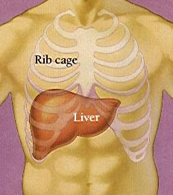
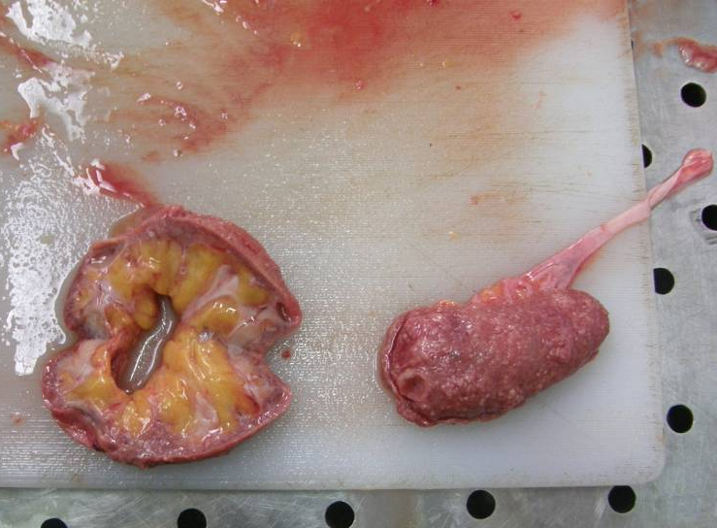
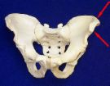
Ib
Analytical & Environmental Studies
Analytical Studies of Human postmortem tissues
Postmortem tissues (kidney cortex,
liver & bone) of 40-60 years
    26 CKDu patients
    16 accident victims
Analyzed for Arsenic, Cadmium & Lead

Slide 62
RESULTS
RESULTS OF POST MORTEM TISSUE
 |  | Arsenic (ug/g) | Cadmium (ug/g) | Lead (ug/g)
Kidney | Mean | 885.54 | 4.04 | 0.89
 | Median | 152.62 | 2.34 | 0.6
 | Minimum | 19.28 | 0.0384 | 0.01
 | Maximum | 7458.54 | 14.16 | 2.54
Liver | Mean | 165.39 | 5.38 | 4.56
 | Median | 117.19 | 2.42 | 3.93
 | Minimum | 22.22 | 0.13 | 0.98
 | Maximum | 1471.41 | 26.16 | 13.33
Bone | Mean | 8.68 | 6.47 | 64.04
 | Median | 4.87 | 4.34 | 47.13
 | Minimum | 0.82 | 0.47 | 2.11
 | Maximum | 70.66 | 28.84 | 233.92
Cadmium & Lead contents in bone tissues of known CKDu patients were higher than that for controls
No significant difference in levels of Arsenic in bones of cases & controls
No significant difference in levels of all 3 metals in kidney cortex & liver tissues of cases & controls

Slide 63
Ib
Analytical & Environmental Studies
Completed….
Cross Sectional Comparison of potential environmental toxins in high and low prevelent areas for CKDu
Case-Control Studies comparing newly diagnosed cases of CKDu and matched controls to identify risk factors for CKDu
Determination of pesticide residues
Analytical Studies of Human postmortem tissues

Slide 64
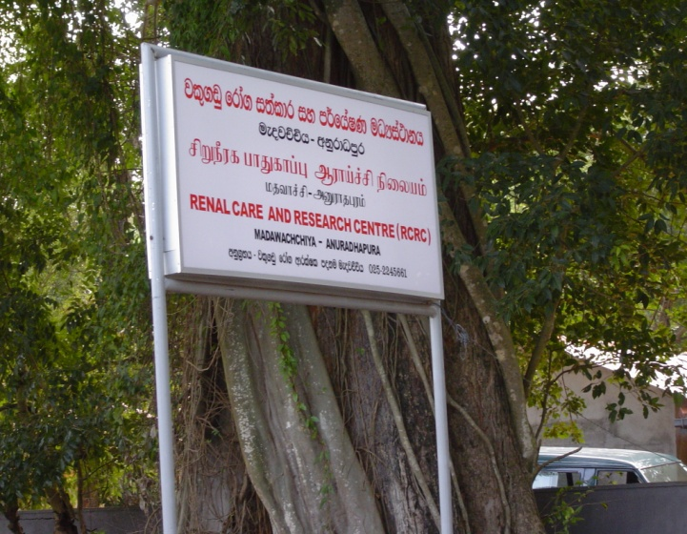
Ic
Hospital Based CKD registry
Main objectives:
To characterize CKD / CKDu population attending renal clinics in :
Database created with following:
  Basic socio-demographics
  Lifestyle
  Environmental factors,
  Anthropometry
  Results of lab investigations
    Medawachchiya DH
    Medirigiriya BH
    Anuradhapura GH
    Polonnaruwa GH

Slide 65
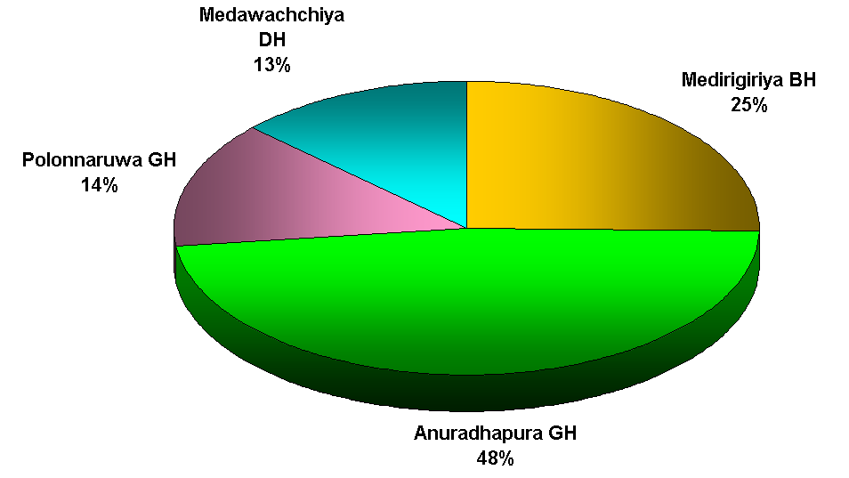
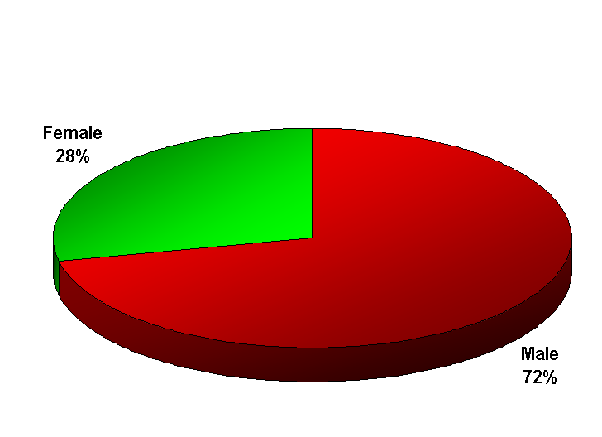
RESULTS
RESULTS OF HOSPITAL BASED CKD REGISTRY
Medawachchiya DH
13%
Medirigiriya BH
25%
Polonnaruwa GH
14%
Female
28%
Male
72%
Anuradhapura GH
48%
Cases Registered in the hospital registry - 1997
True CKDu cases - 775 (39%)
Conversion to a National Registry
Notes:
The database handed over to renal unit – NCP for continuation

Slide 66
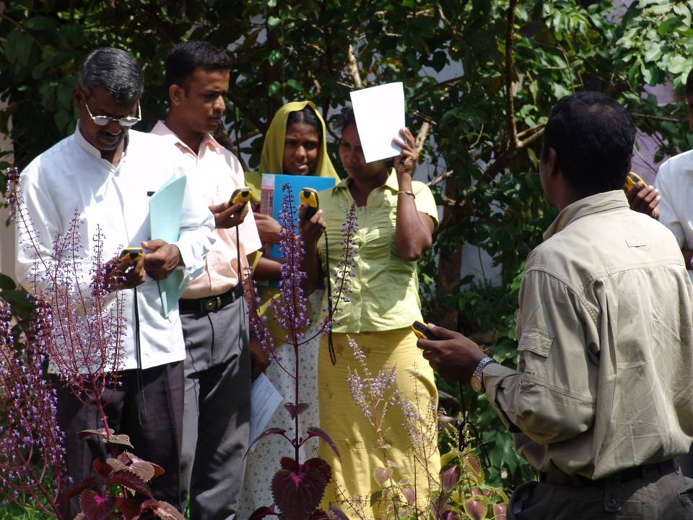
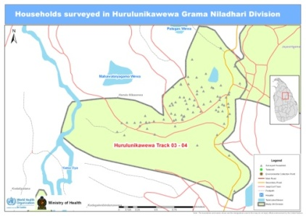
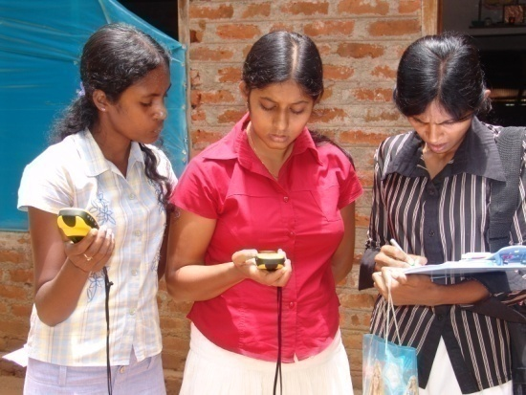
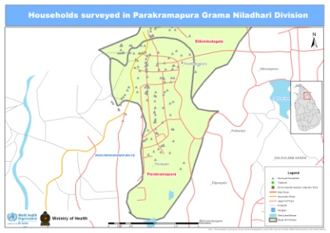
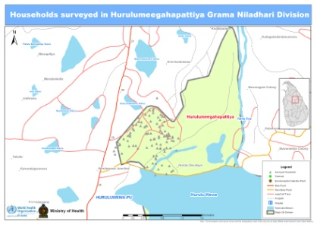
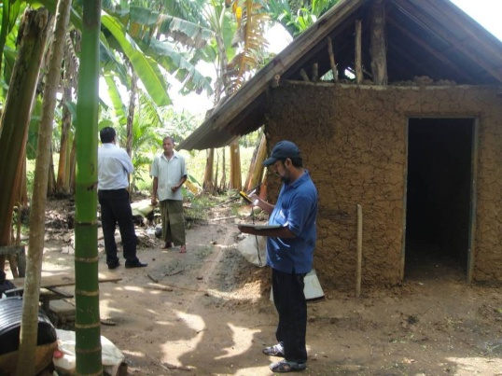
Id
Geographical Mapping of identified variables
Household Maps
Sample Survey Maps
2200 Households mapped upto GN level
Environmental Samples
Water
Food
Tobacco, Beetle & Beedi
Weeds
Soil
Weedicides & Pesticides
Fertillisers
Approximately 450 sampling sites mapped
Capacity of 50 field volunteers built from the area

Slide 67
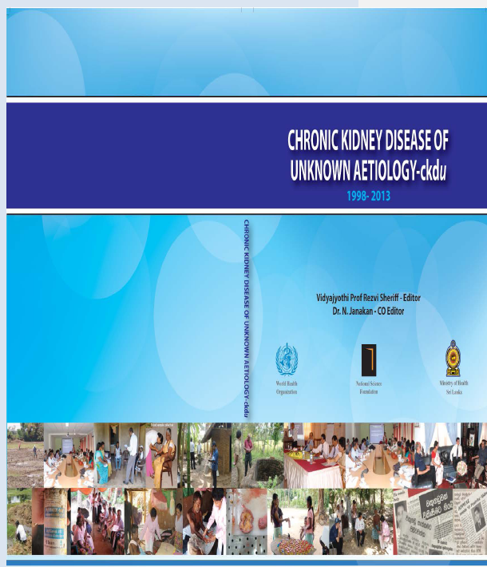
Ie
Id
Establishment of a literature repository for CKD
Collection & Collation of CKDu literature from 1998 - 2003
Literature collected under the following:
Global Perspective
WHO CKD study notes
General
Geographical
Risk Factors
Epidemiological
Heavy Metals
Biochemistry
Histology
Miscellaneous
Water analysis
Flouride
Toxins
Trace elements
Radionuclides
Presentations
Other related literature (International Publications

Slide 68
MAIN SUB PROJECTS OF THE CKDu RESEARCH
I. Prevalence and Causative Factors for CKDu in Sri Lanka
II. Randomized Clinical trial to examine the renal effects of an Angiotensin Converting Enzyme Inhibitor (Enalapril) in adults with CKDu
III. Socioeconomic and productivity impact of CKDu
IV. Nephrotoxic herbal remedies used in Sri Lanka
Notes:
Standard screening tool with optimal sensitivity and specifity and excludes CKD caused by known causes needed – most research use dipstick protein

Slide 69
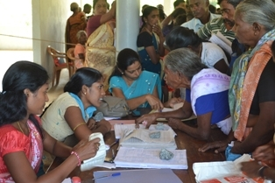
II. Randomized Clinical trial to examine the renal effects of an Angiotensin Converting enzyme Inhibitor (Enalapril) in adults with CKDu
To examine renal effects of Enalapril versus placebo in adults with CKDu by comparing and evaluating the effect of Enalapril to placebo on:
    Estimated GFR
    Albuminuria
    Change in stage of CKDu
Randomized, double blind, placebo controlled clinical trial
Study settings are special clinics organised in
    Anuradhapura TH
    Padaviya BH
    Medirigiriya BH
A total of 266 participants recruited and randomized
Analysis of Results Awaited

Slide 70
RESULTS
RESULTS OF RANDOMISED CLINICAL TRIAL
The maximum concentration of Cadmium in vegetables in the endemic area was 0.322 mg/kg and in the non endemic areas it was 0.063 mg/kg
Levels of Cadmium in Rice in both Endemic & Non Endemic areas were below the allowable limit (0.2mg/kg)
Levels of Cadmium in certain vegetables such as lotus root, and in tobacco, were high. Levels of Cadmium in lotus and tobacco were higher in endemic than in non-endemic areas
Source |  | Cadmium (mg/kg)
 |  | Endemic Area (EA) | Non Endemic Area (NEA)
Lotus | Mean | 0.413 | 0.023
 | Median | 0.066 | 0.023
 | Maximum | 1.50 | 0.03
Tobacco | Mean | 0.351 | 0.316
 | Median | 0.351 | 0.316
 | Maximum | 0.44 | 0.351
Notes:
Cadmium level in Rice by Codex Alimentarius is 0.2mg/kg
Cadmium Level for vegetables by Codex Alimentarius is 0.2mg/kg by commission of european communities is 0.05mg/kg
Provisional Tolerable Weekly Intake (PTWI) for cadmium is 5.8mcg/kg body weight (Joint FAO/WHO expert Committeeon food additives (JECOFA) in 2010 (previously it was 7mcg/kg body weight)
More recently the scientific panel on contaminants in the food chain recommended lowering PTWI of cadmium to 2.52mcg/kg body weight
The PTWI for lead is set at 0.025mcg/kg body weight per week
The PTWI for Arsenic is 0.015mg/kg body weight per week was withdrawn and the recommendation is to keep the concentration of Arsenic as low as possible

Slide 71
MAIN SUB PROJECTS OF THE CKDu RESEARCH
I. Prevalence and Causative Factors for CKDu in Sri Lanka
II. Randomized Clinical trial to examine the renal effects of an Angiotensin Converting enzyme Inhibitor (Enalapril) in adults with CKDu
III. Socioeconomic and productivity impact of CKDu
IV. Nephrotoxic herbal remedies used in Sri Lanka
Notes:
Standard screening tool with optimal sensitivity and specifity and excludes CKD caused by known causes needed – most research use dipstick protein

Slide 72
III. Socioeconomic and productivity impact of CKDu
Consisted of two research components:
To estimate costs of CKDu to individual, household & communities
To understand psychosocial impact
Describe modes of coping at all levels
Evaluate impact of existing coping mechanisms
Hospital Based Study
Community Based Study
IIIa
IIIb
To estimate the socioeconomic impacts of CKDu & to identify methods of easing burden

Slide 73
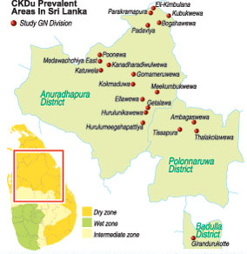
IIIa
Community Based Study
Study area: Padaviya & Madawachchiya DS Divisions
200 questionnaires & in depth interviews
22
Case studies (with regard to death of CKDu person)
16
Key informant Interviews
23
Focus Group discussions

Slide 74
RESULTS
RESULTS OF COMMUNITY BASED STUDY
Community Discourse
Fear with regard to the illness, and social & emotional cost due to stigma
Treatment seeking behavior
Majority go to clinic (public sector) regularly.
Psychosocial Impact
Social & emotional dimensions of patients/ families neglected by healthcare delivery system
No demand for indigenous medical system & private sector services.
A greater demand for religious/ritual healing practices
(attributed to clinical limitations & communication gaps)
Notes:
The database handed over to renal unit – NCP for continuation

Slide 75
RESULTS
RESULTS OF COMMUNITY BASED STUDY (Cont…)
Impact on Everyday life
Affect livelihood activities, domestic tasks & social activities.
Impact on family & community
Drastic changes within the family in the domains of resource allocation, consumption patterns, setting priorities & social relationships.
Struggle to continue with normal lifestyle.
Coping mechanism
Perceive illness as incurable & death is inevitable, & adopt various strategies to cope with the situation.
For some exceptional cases, life has become further active after diagnosis where patients expedited certain tasks to fulfill family & social responsibilities GILGI
Entire community affected due to deteriorating both valuable human resources & material resources
Such strategies often push patients/ families into more poverty & extreme vulnerability.
Lack of institutionalized social support systems further aggravate the situation
CKDu should be looked as not merely a medical issue but as a social issue
Notes:
The database handed over to renal unit – NCP for continuation

Slide 76
IIIb
Hospital Based Study
Hospital Based costing studies
Economic Analysis
Costs to households of treatment & care
Renal Care & Renal Research Centre Anuradhapura
Anuradhapura TH
Madawachiya DH
Padaviya DH
Studies done in:
To determine costs of CKDu to the health system and individual
Medical Costs for each clinic visit
Following analysed:
Average cost per outpatient visit
Average duration of hospital stay
Cost to household of hospital stay
Hospital costs for clinic and inpatient care
Indirect costs from low productivity, absence from work and premature death
For economic analysis and estimation of income and output loss
Data Collection through questionnaires

Slide 77
RESULTS
RESULTS OF HOSPITAL BASED STUDY – COST TO PATIENTS
Clinic patients
Total No of clinic patients – 305
Key demographic features of the clinic patients were:
74% Males
Mean age 56years
98% Sinhalese
98% Buddhists
50% were skilled agriculture and fishery workers whilst 40% were unemployed
54% monthly family income was Rs5000-20000

Slide 78
RESULTS
RESULTS OF HOSPITAL BASED STUDY- COST TO PATIENTS
Clinic patients
74% used the bus to attend clinic
Direct Costs

Slide 79
RESULTS
RESULTS OF HOSPITAL BASED STUDY-COST TO PATIENTS
Clinic patients
Median time spent on the clinic visit by a participant was 8 hours
Indirect Cost of patients seeking clinical care
Indirect Costs

Slide 80
RESULTS
RESULTS OF HOSPITAL BASED STUDY-COST TO PATIENTS
Inpatients
(Including those on dialysis)
Total No of inpatients – 132
Mean duration of hospitalisation – 1 day
Key demographic features of the hospitalised patients were:
71% Males
Mean age 49 years
93% Sinhalese
92% Buddhists
39% were skilled agriculture and fishery workers whilst 63% were unemployed
54% monthly family income was Rs5000-20000

Slide 81
RESULTS
RESULTS OF HOSPITAL BASED STUDY – COST TO PATIENTS
Inpatients
(Including those on dialysis)
56% used a hired three wheeler to reach hospital
Direct Costs

Slide 82
RESULTS
RESULTS OF HOSPITAL BASED STUDY – COST TO PATIENTS
Inpatients
(Including those on dialysis)
Indirect Costs

Slide 83
RESULTS
RESULTS OF HOSPITAL BASED STUDY – COST TO HEALTH SYSTEM
Cost of clinic care
Based on clinic services at Anuradhapura Renal Unit
Utilities
Average Number of patients attending renal clinic per month 1763
Unit cost of clinic care Rs 866.74 per patient visit
Overheads
Personnel

Slide 84
RESULTS
RESULTS OF HOSPITAL BASED STUDY – COST TO HEALTH SYSTEM
Inpatient care
Based on Renal Unit at Anuradhapura TH
Utilities
Average Number of patients hospitalized per month is 1182
Overheads
Unit cost of hospitalization per patient per day is
Rs 3351.32
Personnel

Slide 85
RESULTS
RESULTS OF HOSPITAL BASED STUDY – COST TO HEALTH SYSTEM
Dialysis Care
Based on haemodialysis in the high dependency unit of Anuradhapura TH
Cost of Haemodialysis
Drugs
Rs 607.47
Hospitalization
Rs 1,675.66
Cost of haemodialysis was estimated in a sample of 58 patients
Total Cost per patient per dialysis session is
Rs 7,183.13
Haemodiaysis
Rs 4,900

Slide 86
RESULTS
RESULTS OF HOSPITAL BASED STUDY – COST TO ILLNESS TO COMMUNITY
A sample of 200 patients chosen from Padaviya and Madawachchiya
Main Issue is Poverty !
Three issues identified from cost of care perspective
Travel cost
(Regular clinic care needed sometimes in more than one location)
The need for Multiple Clinic Visits
“Care when needed”-which results in patients seeking off hospital & private sector treatment
Notes:
86

Slide 87
III. Socioeconomic and productivity impact of CKDu
Recommendations
Social Welfare system
To be provided at household level
Transport
Better modes of transport to hospitals and clinics
Health system
Reduce need for private sector investigation
Reduce the need for household purchase of drugs
More provision for haemodialysis
Patient Allowance
To be provided at an earlier stage of the illness
Long waiting times to be reduced

Slide 88
MAIN SUB PROJECTS OF THE CKDu RESEARCH
I. Prevalence and Causative Factors for CKDu in Sri Lanka
II. Randomized Clinical trial to examine the renal effects of an Angiotensin Converting enzyme Inhibitor (Enalapril) in adults with CKDu
III. Socioeconomic and productivity impact of CKDu
IV. Nephrotoxic herbal remedies used in Sri Lanka
Notes:
88

Slide 89
IV. Nephrotoxic herbal remedies used in Sri Lanka
Herbal / Ayurvedhic medicines containing Aristolochic Acid implicated as a causative factor for Renal Disease
Objectives of the study
To examine the species of Aristocholia that grow in Sri Lanka particularly in CKDu high prevalent areas
To list the species that are ingredients of traditional /herbal remedies particularly used in CKDu high prevalent areas

Slide 90
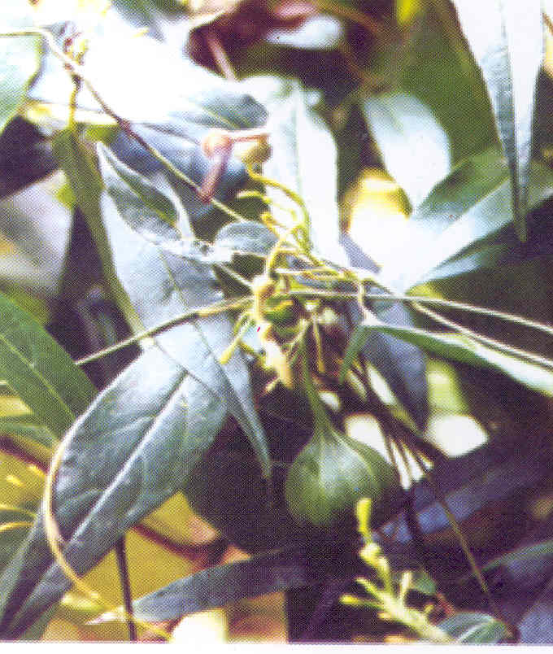
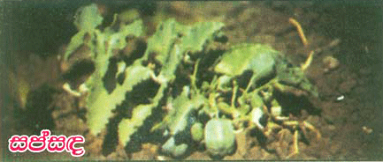
RESULTS
RESULTS OF NEPHROTOXIC HERBAL REMEDY STUDY
Distribution of Aristolochoia Species in Sri Lanka
In Sri Lanka Aristolochoia indica (Sapsanda) is the commonest species used in Ayurvedic Medicine
Other Species found in Sri Lanka:
Aristalochia labiosa
Aristalochia littoralis
Aristalochia bracteolata
Notes:
90

Slide 91
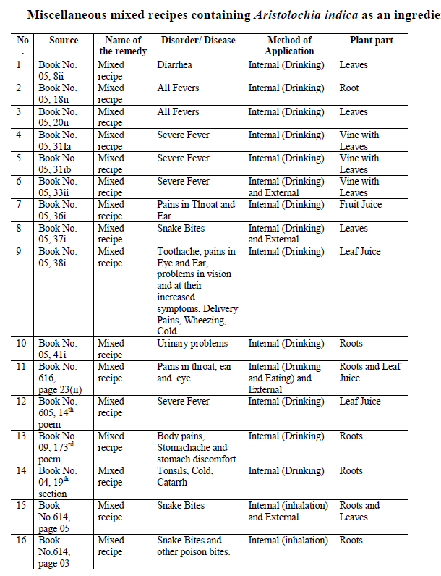
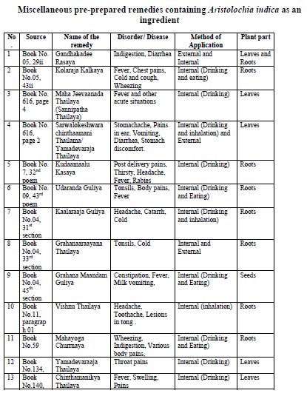
RESULTS
RESULTS OF NEPHROTOXIC HERBAL REMEDY STUDY
Usage of of Aristolochoia Species
In Sri Lanka about 66 Ayurvedic prescriptions contain Aristlochia (Sapsanda/Sasanda) for treatment of more than 20 diseases
Notes:
91

Slide 92
MAIN SUB PROJECTS OF THE CKDu RESEARCH - RECAP
I. Prevalence and Causative Factors for CKDu in Sri Lanka
II. Randomized Clinical trial to examine the renal effects of an Angiotensin Converting enzyme Inhibitor (Enalapril) in adults with CKDu
III. Socioeconomic and productivity impact of CKDu
IV. Nephrotoxic herbal remedies used in Sri Lanka
Notes:
92

Slide 93
CONCLUSION
Results of the study indicates that 15% of the people in the North Central Region are affected by CKDu
Results of this cross sectional study do not indicate that a single agent is responsible for the pathogenesis of CKDu
Based on data reported, this study concludes a triple threat to the kidneys:
  Low levels of Cd through the food chain
  Coupled with deficiency of Selennium
  Concurrent exposure to As and pesticides
Water does not appear to be the source of exposure – However improving water quality and supply will possibly reduce the body burden of heavy metals as well as possible role of Fluoride, Hardness, Ca, Na.
CKDu is causing catastrophic expenditure to the state and the affected individuals and this is leading to a new kind of poverty and stigma in the community

Slide 94
RESPONSE FROM GOVERNMENT OF SRI LANKA TO RESEARCH FINDINGS
October 2012 - Inter-ministerial committee appointed to review indiscriminate use of chemical fertillisers and agrochemicals
October 2012 – Inter-ministrial Officials Committee appointed for CKDu (Ministry Secretaries)
October 2012 – x4 Subcommittees appointed by the ministerial /officials committee
May 2013 –Ministry of Agriculture Cabinet paper presenting 15 recommendations
November 2012 - Parliamentary Advisory Committee on Agriculture
March 2013 – Ministry of Health Cabinet Paper presenting the recommendations of the WHO final report
May 2013 – Minister (Senior) for Rural Affairs & Chairman of the Committee to look into Indiscriminate use of fertilizer & Agrochemicals

Slide 95
INDISCRIMINATE USAGE IF CHEMICAL FERTILIZER AND AGROCHEMICALS
The Ministerial committee
The Officials Committee
Fertlliser use in Sri Lanka with Special reference to CKDu
Pesticides (Including Weedicides, herbicides and fungicides) used in Sri Lanka with special reference to CKDu
Research findings on the effect of soil agriculture, water, fertiliser and pesticide use on CKDu & any other links such as food & drinking water
Organic Agriculture in Sri Lanka
1st Meeting on November 2012

Slide 96
March 2013
Ministry of Health - Cabinet Memorandum
1
Water purification schemes to be scaled up
2
Strengthen the regulatory framework to improve quality control of imported agrochemicals
3
Implement and monitor comprehensive public health measures to reduce the exposure of farmers to harmful health effects of agrochemicals
4
Improve service provision for early detection of CKDu, hypertension and diabetes and appropriate treamtment
5
Increase the financial assistance provided to farmer families affected by CKDu
6
Increase awareness among among Ayurvedic practitioners of the nephrotoxic effects of Aristolochia Indica (sapsanda)
7
Facilitate research to promote the use of alternative fertilizers, reduce heavy metals in soil, develop rice strains which require less fertilizer/resistant to pests, reduce environmental pollution

Slide 97
Ministry of Agriculture - Response
Parliamentary Advisory Committee on Agriculture
Minimize usage of Agro-chemicals
Avoidance of misuse, overuse & abuse of chemical inputs in Agriculture
Identification of research needs by National Committee on Post Harvest Technology & Human Nutrition of the Sri Lanka Council for Agricultural Research Policy (SLCARP)
15 Recommendations Submitted as a cabinet paper
Updated Fertilizer Recommendations for paddy
Banned importation of 4 pesticides
Carbaryl, Chloropyrifos, Carbofuran, Propanil

Slide 98
May 2013
Ministry of Agriculture - Cabinet Memorandum
15 Recommendations
1
Establishment of Statutory Technical Council to promote environmentally friendly agriculture
2
Establishment of new Sri Lankan Standards (SLS) on pesticides and agrochemicals
3
To make orders under the Pesticide Control Act to retain heavy metals and impurities to a minimum possible level
15
Re
4
Establishing methodology for controlling under-growth (weeds) of paddy cultivation & encouraging farmers to cultivate alternate crops for minimizing the use of pesticide
5
Strengthening legal framework to authorize state officials including the health sector & Grama niladhari to take legal action against those resorting to indiscriminate use of pesticides and those supporting the same
6
To prohibit the use of Propane, Glyphosate, Carbayl and Chlorpyrifos which have been identified as harmful pesticides in areas where kidney diseases are spreading

Slide 99
Ministry of Agriculture - Cabinet Memorandum (Cont..)
7
In view of the health risk, taking measures to minimize the use of all chemical fertilizers while encouraging farmers to adopt alternative methods
8
Minimise the use of imported phosphate and increase production and use of local phosphates
9
Testing all fertilizer varieties with health risk posed due to heavy metal and toxic ingredient content and establishment of revised standard for the same
10
Strengthening of legal background & establishment of laboratory facilities for frequent testing of agro-chemical impurities
11
Educate the public on the harmful effects on human health due to the use of agro-chemicals and their safety and efficient use
12
Prohibit pesticide and agro-chemical fertilliser advertising over electronic & print media

Slide 100
Ministry of Agriculture - Cabinet Memorandum (Cont..)
13
Establishment of a safety method for recycling/disposal of empty pesticide containers/bottles and fertillizer bags
14
Providing people in Kidney disease prone areas with drinking water free of insipid water
15
Impose a 10% health safety cess on all imported pesticide varieties and the levied amount to be used for welfare of the kidney patients and research activities

Slide 101
Minister (Senior) for Rural Affairs & Chairman of the Committee to look into the indiscriminate usage of chemical fertilizer & Agrochemicals
May 2013
SHORT TERM RECCOMMENDATIONS
1
Launch an islandwide program to identify CKDu patients with special attention to NCP & take action to declare CKDu as a notifiable disease
2
Carry out surveys using GIS to identify all CKDu hotspots upto Grama Niladhari Division
3
Declare CKDu hotspots and take all initiatives, to establish casual factors and to mitigate CKDu in the prevalent areas
4
Establish a high powered policy implementation body to carry out further research on establishing the exact causal factors of CKDu and to control CKDu and CKD under an appropriate ministry and to coordinate and implement the recommendations

Slide 102
Minister (Senior) for Rural Affairs & Chairman of the Committee to look into the indiscriminate usage of chemical fertilizer & Agrochemicals (Cont…)
5
Launch a multidisciplinary further research program to cover all spectrum of CKDu and to strongly establish the causal factor for CKDu
6
Further analyze the fertilizer recommendation scheme while paying specail attention to the environmental consequence of the scheme
7
Implement an integrated awareness program to address all important aspects of CKDu and to promote suitable agricultural practices
8
Include the impact of heavy metals on human health & environment and safe use of pesticides and fertilliser into curricular of Geography, Agriculture, Health Science and science in secondary schools
9
Establish an independent accredited laboratory & upgrade the existing laboratories with facilities such as trained staff & sophisticated equipments to analyse trace elements (Cd, As, Pb,Fe,Mn etc) pesticide residues & other elements related to CKDu

Slide 103
Minister (Senior) for Rural Affairs & Chairman of the Committee to look into the indiscriminate usage of chemical fertilizer & Agrochemicals (Cont…)
10
Regulate the promotional activities related to fertilisers & pesticides carried out by the agrochemical companies/institutions carried out by mass media
11
Establishment of legal provisions for mandatory requirements in relation to standards
12
Provide drinking water with low or no hardness to communities in CKDu endemic areas by way of providing effective filters and/or delivering portable water with acceptable quality
13
Promote & implement rain water harvesting structures with quality monitoring systems and make regulations for all new buildings in CKDu areas to be equipped with rain water harvesting units
14
Select high priority CKDu hotspots & establish “Green Zones” that are free of major potential CKDu casual inputs

Slide 104
Minister (Senior) for Rural Affairs & Chairman of the Committee to look into the indiscriminate usage of chemical fertilizer & Agrochemicals (Cont…)
15
Provide subsidy & marketing facilities for the farmers who make attempts to move from agrochemicals to alternate farming
16
Establish a fund for the welfare of CKDu patients, for carrying out research and financing for fund through economic instruments based on the polluter pay principles and producer responsibility as well as CSR
17
Enhance the medical facilities for CKDu patients with immediate effects in the affected areas
18
Facilities of the traditional medical practitioners to carry out their treatments for the affected people based on the patient interest & demand
19
Expedite the establishment of proposed chemical fertilliser manufacturing plant to produce fertilliser with minimum/standard limits of heavy metals using Eppawella rock phosphate

Slide 105
Minister (Senior) for Rural Affairs & Chairman of the Committee to look into the indiscriminate usage of chemical fertilizer & Agrochemicals
LONG TERM RECCOMMENDATIONS
20
Establish procedures for examination of quality of agrochemicals at boarder poits, Factory outlets, wholesale & retail shops in the districts
21
Establish long term water quality monitoring system by an accredited agency under direct supervision of a government institution.
22
Capacity building of grass root level officers to educate farmers on use of minimum pesticides and fertillisers
23
Prepare necessary maps indicating zones for active, potential and prone to agrochemical contamination
24
Redesign land use pattern, crop & land implementation plans covering soil & water drainage engineering aspect & climatic parameters

Slide 106
Minister (Senior) for Rural Affairs & Chairman of the Committee to look into the indiscriminate usage of chemical fertilizer & Agrochemicals (Cont…)
25
Establish river banks, green manure banks, neem avenues, herbal gardens, compost bays and strict declaration of non toxic zones
26
Identify farmers/farmer groups and designate them as responsible agents/agri environment guard with authority to regulate the inputs used in agriculture
27
Introduce programmes for organic and sustainable certification to receive premium prices for farm products
28
Establish appropriate CSR avenues through Banks, Insurance companies, NGOs, local institutions for possible subsidy or incentives for proposed curative and corrective measures
29
Conduct extended cost benefit analysis for the use of agrochemicals in consideration of their impact on environmental & social effects

Slide 107
Ministry of Water Supply and Drainage
National Water Supply & Drainage Board
1
Parliamentary Sub committee appointed to coordinate mitigation measures
2
Concept paper and action plans have been prepared for supplying safe drinking water to all affected areas
3
District wise action items/sub projects have been identified
4
Implementation Plans
SHORT TERM:
Water for drinking and cooking using small RO (Reverse Osmosis) plants
Rain water harvesting
MEDIUM TERM:
Medium sized water supplies based on surface water
Water Supply extensions
LONG TERM:
Major Integrated Water Supply projets

Slide 108
Ministry of Social Services
Draft Cabinet paper prepared for
1
To adhere to the Ministry of Health-World Health Organization criteria in order to diagnose the disease
2
To pay monthly assistance of Rs 1500 each for kidney patients who do not require dialysis (Stated in Grade 2/3)
3
To pay monthly assistance of Rs 3000 each for kidney patients who require dialysis (Stated in Grade 3/4)
At present a monthly assistance is paid for only a few patients through Provincial social Services Department and ranges from Rs 500 - 1000

Slide 109
Follow-up of Recommendations
Ministry of Health
Strengthening of the Health Services as per the recommendations (In progress)
Ministry of Agriculture
Regulations on Indiscriminate use of Fertilizers /Pesticides (Cabinet Subcommittee -15 priority areas)
Ministry of Water Supply & Drainage
Improvement of Water Quality (Already in place)
Ministry of Indigenous Medicine
Regulatory mechanism to be initiated for reduction of use of Aristolochia (Sapsanda/Sasanda)
Ministry of Environment
Contribution towards reduction of causative factors
Ministry of Science & Technology
Supported the National Research effort together with WHO
Continue research in identified areas
Ministry of Social Services
Strengthening the social service component and facilitating the provision of patient allowance at an earlier stage

Slide 110

CONCLUSION
Sri Lanka has done work in the area of CKDu over many years. With a coordinated research initiative over a period of 27 months funded by NSF and WHO has yielded evidence to initiate policy dialogue which has resulted in the highest political commitment translated into action by different stakeholders and ministries.
Thank You

